Slide 1
Using ivy csv file utilities to program workflows
2017-01-13
Allart Ian Vogelesang ian.vogelesang@hds.com +1 408 396 6511

Slide 2
What is an ivy workflow?
An ivy workflow is when you perform a test step using the ivy engine and then you examine what happened and decide what to do next.
.ivyscript is the ivy workflow programming language
.ivyscript itself looks a lot like C/C++, but it also has
Ivy engine control statements [CreateRollup] "port" [quantity] 16;
Builtin functions to access a csv file with a column title header row as if it were a spreadsheet by row and column.
These builtin csv file access utilities are also provided in the form of standalone command line executables for use outside ivy.

Slide 3
Live access to ivy data structures
The only code that has access to ivy in-memory data structures while a subinterval sequence or "test step" is running is the dynamic feedback control mechanism.
Runs at end of subinterval after all test host and subsystem data is in
Can send out real-time workload parameter updates to rollup instances

Slide 4
Flexibility + Simplicity
Provide the maximum flexibility for scripting ivy workflows with a modest investment of programming time
Combination of two parts
Write out all ivy data structures as csv files with a column title (header) row
Provide the scripting language with
Scripting interpreter built-in functions to retrieve handy things to build csv file name, things like overall test folder names, or the name of the folder for the most recent test step*.
"spreadsheet-type" accessor functions that can also use column titles ("Overall IOPS") to select the column
* corresponding "get" and "set" methods to be added to ivy C++ API

Slide 5
.ivyscript builtin functions
string outputFolderRoot(); from [OutputFolderRoot] statement – default "."
string testName(); root part of ivyscript file without .ivyscript suffix
string masterlogfile(); you can log(masterlogfile(), "message\n");
string testFolder(); root folder for output from this run
string stepNNNN(); from most recent [Go!], e.g. step0002
string stepName(); from most recent [Go]
string stepFolder(); subfolder for most recent [go] within testFolder()
string last_result(); for most recent [Go], returns "success" or "failure"
string show_rollup_structure(); shows type / instance / workload thread hierarchy.
Corresponding "get" and "set" methods to be added to ivy C++ API

Slide 6
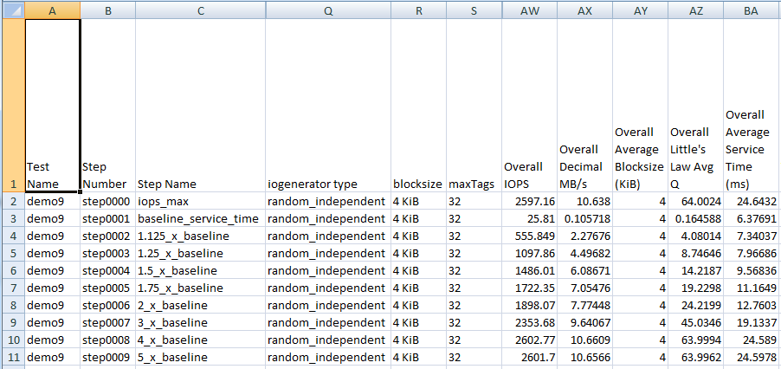
ivy csv file numbering – the header row is -1
Test step csv files (not shown) have one line per subinterval
(both host & subsystem data) Summary csv files like this one have one line per test step.
Header row is row -1
Row 0 is test step 0 or subinterval 0
Use column number from 0, or say "Overall IOPS"

Slide 7
.ivyscript builtins vs. command line utilities
The .ivyscript interpreter has a csvfile object type, and gives you functions to load a csv file into the set of currently-loaded csv files, examine the most recently set csvfile and to drop a csv file when you are finished with it, if it takes a lot of memory and it matters.
This optimizes for low overhead of making multiple accesses to a single csv file.
The standalone command line utilities on each invocation load a csv file object with the target csv file in order to extract what was asked for.

Slide 8
.ivyscript csv file builtin functions 1/3
set_csvfile(string filename);
Loads csv file into a kind of spreadsheet object, if it's not already loaded into memory.
You can load multiple csv files and switch back and forth.
All subsequent csvfile calls refer to the currently set csvfile.
drop_csvfile(string filename);
If you are done with it and you would like to release the space.
int csvfile_rows();
Number of rows following the header row.
Returns -1 if invalid file or file empty. Returns 0 if there was only a header row.
int csvfile_columns_in_row(int row); int csvfile_header_columns(); same as csvfile_columns_in_row(-1)

Slide 9
.ivyscript csv file builtin functions 2/3 – individual cells
string csvfile_cell_value(int row, int column); string csvfile_cell_value(int row, string column_header_text);
You can refer to a column using an int, the column index from zero.
You can refer to a column using a string, the column header text.
string csvfile_raw_cell_value(int row, int column); string csvfile_raw_cell_value(int row, string column_header_text);
ivy "wraps" text fields as a formula with a string constant, e.g. ="horse"
This stops Excel from interpreting 1-1 as January 1st, and 00:00 from interpreting as a time.
The csv file functions normally "unwrap" csv column values, removing this kind of wrapper or removing simple double quotes surrounding a value, to treat ="horse", "horse" and horse the same
Retrieving the raw value give you exactly what was between the commas in the csv file.

Slide 10
.ivyscript csv file builtin functions 3/3 – headers & slices
string csvfile_column_header(int col);
Give you the text of the column header
string csvfile_column(int col); string csvfile_column(string column_header);
Gives you a "column slice" of the spreadsheet showing "raw" values.
E.g. "IOPS,55,66,55,44"
Demo number 9 shows iterating through the column slices to write out the transpose of a csv file.
string csvfile_row(int row);
Gives you a "row slice" of the spreadsheet showing the "raw" values.
E.g. ="random_independent",="4 KiB",32,2601.7

Slide 11
Command line executables – ivy csv file utilities
To make it easy to navigate ivy output csv files from other scripting or programming languages, the .ivyscript csv utilities are also provided in the form of standalone command line executables.
Note: when you specify command line arguments, it can be a pain with bash if you are dynamically generating commands to be executed if any of the command line arguments have spaces in them.
Fortunately, ivy treats "Overall IOPS" as equivalent to overall_iops

Slide 12
ivy's use of Excel formula format values
In order to prevent Excel from interpreting a cell according to its value, for example to prevent Excel from storing the cell value as the date January 1st when the csv file says "1-1", ivy uses the trick to show a character string as a formula, as in ="1-1".
In these utility functions, when you retrieve using "csv_cell_value", any ivy formula wrapper is removed, and quoted strings are unpacked, meaning the quotes are removed and escaped characters are rehydrated.
The "csv_raw_cell_value" executable gives you the exact original text between the commas in the csv file.
If something goes wrong, each of the ivy csv utility executables will say something starting with <Error>.

Slide 13
Command line ivy csv file utilities 1/4
csv_lookup_column filename column_header
returns the column number for the specified column title (column header).
e.g. csv_lookup_column x.csv "Overall IOPS"
csv_column_header filename column_number
prints the column header for the specified column number
e.g. csv_column_header x.csv 0
csv_rows filename
prints the number of data rows following the header row.
prints 0 if there is only a header row.
e.g. csv_rows x.csv

Slide 14
Command line ivy csv file utilities 2/4
csv_header_columns filename
prints the number of columns (number of un-quoted commas plus one) in the header row
e.g. csv_header_columns /home/user/Desktop/a.csv
csv_columns_in_row filename row_number
prints the number of columns (number of un-quoted commas plus one) in the specified row
e.g. csv_columns_in_row x.csv 3
csv_raw_cell_value filename row_number column_number csv_raw_cell_value filename row_number column_header
prints the exact characters found between commas in the csv file
e.g. csv_raw_cell_value x.csv 4 5 e.g. csv_raw_cell_value x.csv 4 "Overall IOPS"

Slide 15
Command line ivy csv file utilities 3/4
csv_cell_value filename row_number column_number csv_cell_value filename row_number column_header
e.g. csv_cell_value x.csv 4 5 e.g. csv_cell_value x.csv 4 "Overall IOPS"
This "unwraps" the raw cell value.
First if it starts with =" and ends with ", we just clip those off and return the rest.
Otherwise, an unwrapped CSV column value first has leading/trailing whitespace removed and then if what remains is a quoted string, the quotes are removed and any internal "escaped" quotes have their escaping backslashes removed.

Slide 16
Command line ivy csv file utilities 4/4
csv_row filename row_number
prints the entire row
e.g csv_row x.csv 2
csv_column filename column_number csv_column filename column_header
prints column slice
e.g. csv_column x.csv 4 e.g. csv_column x.csv "Overall IOPS"

Slide 17
Demo csv file with retrieval script provided
See test_csv.csv, test_csv.sh, and test_csv.sh.output.txt in the doc subfolder at https://github.com/Hitachi-Data-Systems/ivy.

